Slide 1

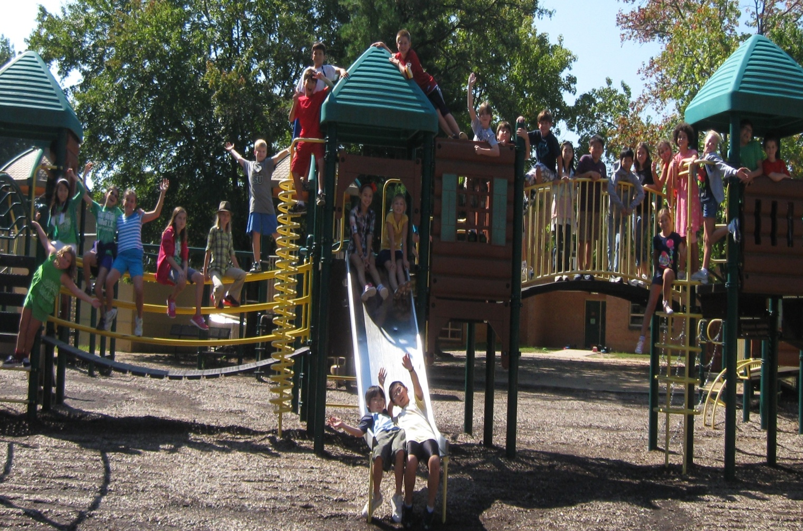
Welcome to
Back-to-School
Night
Ms. Diapoulis
4th Grade AAP
September 16, 2015

Slide 2
Meet the Teacher
Grew up in Alexandria, VA all of my life
Graduated from James Madison University with a B.A in Interdisciplinary Liberal Studies and a Masters of Arts in Teaching.
Student taught here at CWES in 4th grade AAP and 3rd grade
Long-term substitute for 5th grade AAP at the end of last year

Slide 3
A Typical Day in Fourth Grade
Time
9:05 – 9:15
9:20 – 9:40
9:40 – 10:50
10:50 – 11:20
11:20 – 11:50
11:50 – 12:00
12:00 – 12:50
12:50 – 1:50
1:50 – 3:30
Activity
Arrival
Morning Meeting
Math
Lunch
Recess
Zen 10
Science/Virginia Studies
Specials
Reading & Writing Workshop

Slide 4
Fourth Grade Specials
Monday: Music and PE
Tuesday: Art
Wednesday: Art
Thursday: Music and PE
Friday: Music and PE
*Library will be on an as-need basis
*Guidance is scheduled once a month

Slide 5
Components of Responsive Classroom
Morning Meeting Academic Choice
Hopes & Dreams →Class Rules
Redirecting, reminding, reinforcing
Logical Consequences
  “Take a break”
  “You broke it. You fix it.”
  Loss of privilege

Slide 6

CETA
Changing Education Through the Arts (CETA)
The mission of CETA is to help students learn through arts integrated instruction.
Classes will use structures such as tableaus and reader’s theater to integrate the arts into the classroom.

Slide 7
What We Will Accomplish
Language Arts Components
  Reading
    Fiction, Nonfiction, Poetry
      Biographies and Autobiographies
      Historical and Realistic Fiction
    Functional Formats
      Advertisements, flyers, directions
    Use text features
    Select and use appropriate resources
    Read for meaning, fluency, accuracy, and expression
    Maintain a reading log
  Reading Workshop
    Guided Reading in small groups
    Literature Circles in small groups

Slide 8
  Writing
    6+1 Writing Traits
    Lucy Caukins Writing Program
    “Being a Writer” Writing Program
    Writer’s craft lessons and grammar lessons
    Research skills
  Spelling and Vocabulary
    Caesar’s English
    Word Study

Slide 9
Social Studies
  Virginia Studies
    Geography of Virginia
    Woodland Indians
    Jamestown
    Colonial Life
    Revolutionary War
    Civil War
    Reconstruction
    Civil Rights
    20th Century and Beyond

Slide 10
Math (4th and 5th material)
  Patterns
  Place Value
  Fractions and Decimals
  Properties of Whole Numbers
  Measurements
  Elapsed Time
  Geometry
  Graphing
  Probability
  The math textbook is entirely online. Instructions on how to gain access will be posted on Blackboard.
  STUDENTS WILL TAKE THE 4th GRADE MATH SOL

Slide 11
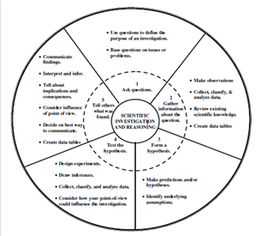
Science
  Units
    Magnetism and Electricity
    Weather and Space
    Force and Motion
    Plant Anatomy
    Virginia Ecosystem
  Grades are based on the upkeep and responses to student labs and discussion during groups
  Quizzes after each lesson
  Tests after each unit

Slide 12

Standardized Testing
Fourth Grade SOLs
  Reading
  Math (take 4th grade)
  Virginia Studies
  All SOL tests are online.

Slide 13
How Will They Earn Their Grades?
Summative Assessments
  Tests and Quizzes
    Science Quizzes and Unit Tests
    Reading Projects and Assignments
    Weekly Spelling, Daily Oral Language, or Caesar’s English quizzes
    Math Quizzes and Unit Tests
  Papers and Projects
    Grades will be based on rubrics that students have an opportunity to view
Formative Assessments
  Participation during small and large group
  Cooperation and dedication to group projects
  Completion of class work and homework

Slide 14


Slide 15
Effort Grades
Participation
Quality of work produced
Perseverance
Receptivity to feedback
Homework completion
Notes:
Distribute Effort guidelines
Effort is not standards-based – teachers need to be able to justify grades with specific examples of what students do.

Slide 16
Achievement Rubric
4 – Consistently demonstrates
3 – Usually demonstrates
2 – Sometimes demonstrates
1 – Seldom demonstrates
na – no summative assessment data
nt – not taught

Slide 17
Final Marks on Progress Report
Indicate where a student is in relation to the standards at the end of the year
NOT an average for the year

Slide 18
Homework Policy
Students can begin to expect roughly 1 hour of homework Monday through Thursday.
Includes weekly spelling, Daily Oral Language, Caesar’s English assignments, math practice, science and Virginia studies assignments
Students may also be asked to complete work not finished in class. This may or may not be calculated into the 60 minutes.
Nothing should be sent home that has not been discussed in class (refer to agenda or interactive notebook)
Students will be responsible for taking home all materials needed
Time is given at the end of the day to pack up and record homework in agenda.
Homework will be checked in every morning and recorded as an Effort grade.

Slide 19
Homework Help
How to help your child
  Assist when needed and allow for self-discovery
  Organize and create a plan/schedule!
  Clarify directions on assignments
  Review information in interactive notebooks
  Review for quizzes and tests
How much is too much?
  If your child is spending more than one uninterrupted hour on homework every night or quickly reaches frustration level, please do not hesitate to contact me. Together we can create a plan.

Slide 20
Muddy, Buggy, Clear
On each homework assignment, I ask that the students write one of the following on their assignment. This allows me to know how well a student understood their homework.
Muddy – I didn’t really understand it all by myself. I needed someone to help me through most of it. I probably need more help at school.
Buggy – Some spots I didn’t understand, and I needed a little help from someone. I might need a little help at school.
Clear – I understood most of the work myself. I feel like I don’t need help at school.

Slide 21
Student Absences
Please notify me if your student will be absent. This allows me to accumulate a homework folder for your student’s return to school!
For extended leave, please let me know as soon as possible and I will be happy to provide material to your student.
Students are allowed 1 day to complete make-up work for every day absent.
Ex. 2 missed days equals 2 days to make-up work.
I am happy to send home work with a sibling or friend, or leave work in the office for someone to pick up!

Slide 22
Communication on Progress
How will I be updated about my child’s progress?
  Weekly work status cards will be sent home in Tuesday folders
    Folders MUST be back to school by the following Wednesday
I will notify parents if a student is beginning to struggle with a subject!

Slide 23
Special Events
Kennedy Center Concert
Planetarium – Weather/Space Unit
Winter Party – December
Richmond Field Trip – Spring
Virginia Day – Spring
End of Year Party - Summer

Slide 24
Food and Allergy Policy
2014 – 2015 Classroom Treat Policy
  Grade levels are allowed 2 food events per school year
    Fourth Grade – Winter Party and Virginia Day
  Birthday treats must be given 48 hours notice to the classroom teacher
    CWES is requesting that parents consider other birthday treat options (not food related).

Slide 25
Home & School Communication
  Check agenda daily
  Blackboard – updated weekly
    Documents will be uploaded as they are introduced to students
  Classroom Website (adventuresinfourthgradecwes.weebly.com) is a supplemental site to improve communication
  Weekly newsletter sent home in mailbags
  Take Home Tuesday Folders
  Conference by appointment
  Email: sediapoulis@fcps.edu
  School Phone : (703) 764-5685

Slide 26
Thank you for coming! I am looking forward to a phenomenal year!

